Slide 1
Data Mining
Lecture 8

Slide 2
Course Syllabus
Classification Techniques (Week 7- Week 8- Week 9)
  Inductive Learning
  Decision Tree Learning
  Association Rules
  Regression
  Probabilistic Reasoning
  Bayesian Learning
Case Study 4: Working and experiencing on the properties of the classification infrastructure of Propensity Score Card System for The Retail Banking (Assignment 4) Week 9

Slide 3
Classification vs. Prediction
Classification
  predicts categorical class labels (discrete or nominal)
  classifies data (constructs a model) based on the training set and the values (class labels) in a classifying attribute and uses it in classifying new data
Prediction
  models continuous-valued functions, i.e., predicts unknown or missing values
Typical applications
  Credit approval
  Target marketing
  Medical diagnosis
  Fraud detection

Slide 4
Classification—A Two-Step Process
Model construction: describing a set of predetermined classes
  Each tuple/sample is assumed to belong to a predefined class, as determined by the class label attribute
  The set of tuples used for model construction is training set
  The model is represented as classification rules, decision trees, or mathematical formulae
Model usage: for classifying future or unknown objects
  Estimate accuracy of the model
    The known label of test sample is compared with the classified result from the model
    Accuracy rate is the percentage of test set samples that are correctly classified by the model
    Test set is independent of training set, otherwise over-fitting will occur
  If the accuracy is acceptable, use the model to classify data tuples whose class labels are not known

Slide 5



Process (1): Model Construction
Classification
Algorithms
Training
Data
Classifier
(Model)
IF rank = ‘professor’
OR years > 6
THEN tenured = ‘yes’

Slide 6




Process (2): Using the Model in Prediction
Classifier
Testing
Data
Unseen Data
(Jeff, Professor, 4)
Tenured?

Slide 7
Supervised vs. Unsupervised Learning
Supervised learning (classification)
  Supervision: The training data (observations, measurements, etc.) are accompanied by labels indicating the class of the observations
  New data is classified based on the training set
Unsupervised learning (clustering)
  The class labels of training data is unknown
  Given a set of measurements, observations, etc. with the aim of establishing the existence of classes or clusters in the data

Slide 8
Issues: Data Preparation
Data cleaning
  Preprocess data in order to reduce noise and handle missing values
Relevance analysis (feature selection)
  Remove the irrelevant or redundant attributes
Data transformation
  Generalize and/or normalize data

Slide 9
Issues: Evaluating Classification Methods
Accuracy
  classifier accuracy: predicting class label
  predictor accuracy: guessing value of predicted attributes
Speed
  time to construct the model (training time)
  time to use the model (classification/prediction time)
Robustness: handling noise and missing values
Scalability: efficiency in disk-resident databases
Interpretability
  understanding and insight provided by the model
Other measures, e.g., goodness of rules, such as decision tree size or compactness of classification rules

Slide 10
Basis of Classification: Inductive Learning
the problem of automatically inferring the general definition of some concept, given examples labeled as members or nonmembers of the concept.
Concept learning. Inferring a boolean-valued function from training examples of its input and output.

Slide 11
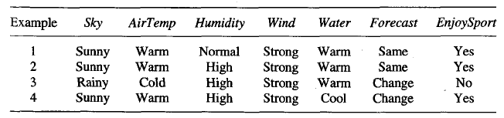
Basis of Classification: Inductive Learning
let’s define our problem as
"days on which my friend Aldo enjoys his favorite water sport"
The task is to learn to predict the value of EnjoySport for an arbitrary day, based on the values of its other attributes

Slide 12
Basis of Classification: Inductive Learning
Hypothesis Represantation is Critical
(How you do that, in what way you do that)
let each hypothesis be a vector of six constraints, specifying the values of the six attributes Sky, AirTemp, Humidity, Wind, Water, and Forecast. For each attribute,
the hypothesis will either
  indicate by a ‘?’ that any value is acceptable for this attribute,
  specify a single required value (e.g., Warm) for the attribute, or
  indicate by a ‘0’ that no value is acceptable
if some instance x satisfies all the constraints of hypothesis h, then h classifies x as a positive example (h(x) = 1)

Slide 13
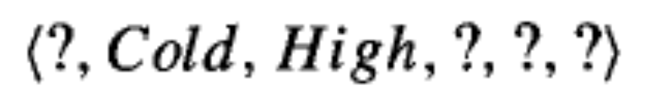

Basis of Classification: Inductive Learning
Hypothesis Represantation is Critical
(How you do that, in what way you do that)
the hypothesis that Aldo enjoys his favorite sport only on cold days with high humidity (independent of the values of the other attributes) is represented by the expression
the most general hypothesis-that every day is a positive example-is represented by
and the most specific possible hypothesis-that no day is a positive example-is represented by

Slide 14
Basis of Classification: Inductive Learning
Inductive Learning Hypothesis
Although the learning task is to determine a hypothesis h (our estimate function) identical to the target concept c (desired function) over the entire set of instances X, the only information available about c is its value over the training examples. Inductive learning algorithms can at best guarantee that the output hypothesis fits the target concept over the training data. Lacking any further information, our assumption is that the best hypothesis regarding unseen instances is the hypothesis that best fits the observed training data
Any hypothesis found to approximate the target function well over a sufficiently large set of training examples will also approximate the target function well over other unobserved examples

Slide 15
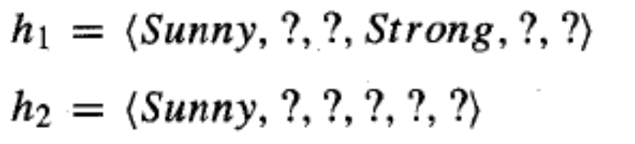
Basis of Classification: Inductive Learning
Concept Learning – General to Specific Relationship
Now consider the sets of instances that are classified positive by hl and by h2. Because h2 imposes fewer constraints on the instance, it classifies more instances as positive. In fact, any instance classified positive by hl will also be classified positive by h2. Therefore, we say that h2 is more general than hl.

Slide 16
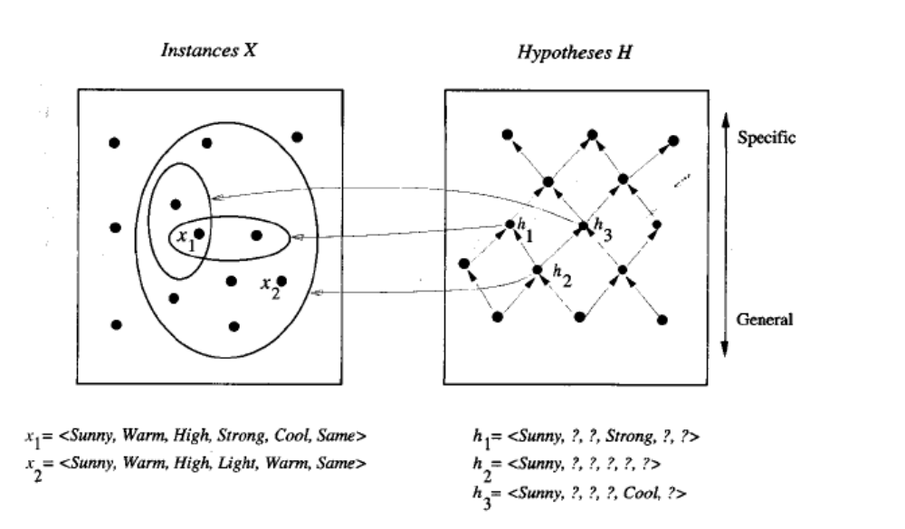
Basis of Classification: Inductive Learning
Concept Learning – General to Specific Relationship depends only on which instances satisfy the two hypotheses and not on the classification of those instances according to the target concept

Slide 17
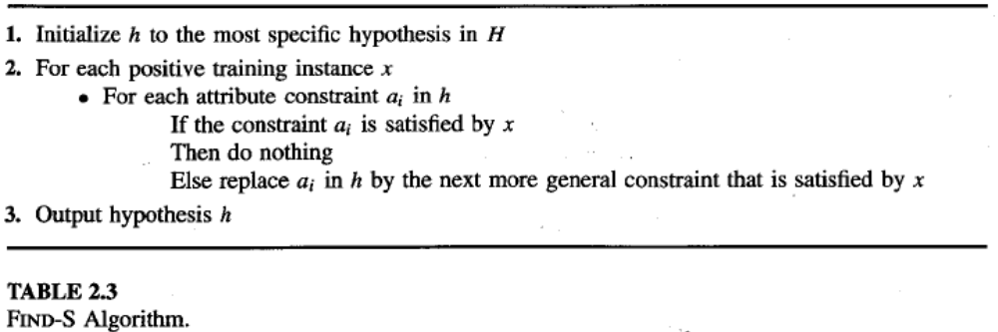
Basis of Classification: Inductive Learning
Find –S Algorithm
Begin with the most specific possible hypothesis in H, then generalize this hypothesis each time it fails to cover an observed positive training example. (We say that a hypothesis "covers" a positive example if it correctly classifies the example as positive.)

Slide 18


Basis of Classification: Inductive Learning
Find –S Algorithm
FIND-S algorithm simply ignores every negative example! as long as we assume that the hypothesis space H contains a hypothesis that describes the true target concept c and that the training data contains no errors, then the current hypothesis h can never require a revision in response to a negative example

Slide 19
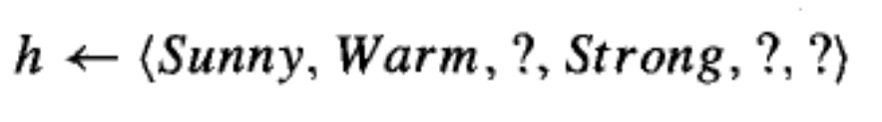
Basis of Classification: Inductive Learning
Find –S Algorithm

Slide 20
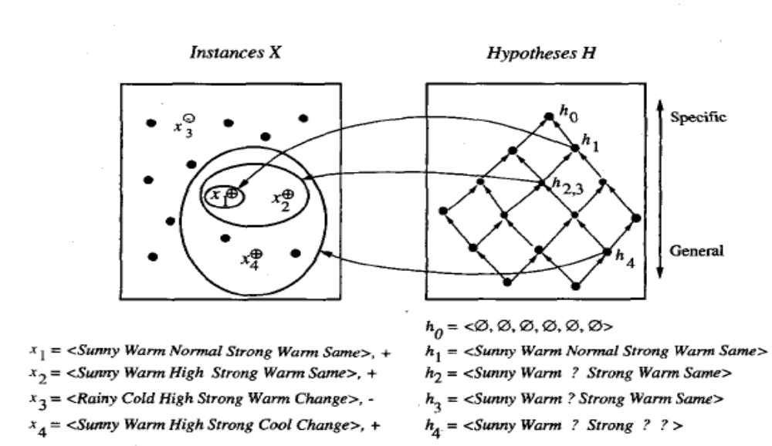
Basis of Classification: Inductive Learning
Find –S Algorithm (Specific to General Walk)

Slide 21
Basis of Classification: Inductive Learning
Comments on Find –S Algorithm
FIND-S is guaranteed to output the most specific hypothesis within H that is consistent with the positive training examples. Its final hypothesis will also be consistent with the negative examples provided the correct target concept is contained in H, and provided the training examples are correct
Problems of Find –S Algorithm
Has the learner converged to the correct target concept?
Although FIND-S will find a hypothesis consistent with the training data,
it has no way to determine whether it has found the only hypothesis in H
consistent with the data (i.e., the correct target concept), or whether there
are many other consistent hypotheses as well. We would prefer a learning
algorithm that could determine whether it had converged and, if not, at least
characterize its uncertainty regarding the true identity of the target concept

Slide 22
Basis of Classification: Inductive Learning
Comments on Find –S Algorithm
Problems of Find –S Algorithm
Why prefer the most specific hypothesis?
In case there are multiple hypotheses consistent with the training examples,
FIND-S will find the most specific. It is unclear whether we should prefer this
hypothesis over, say, the most general, or some other hypothesis of intermediate
generality
Are the training examples consistent?
In most practical learning problems there is some chance that the training examples will contain at least some errors or noise. Such inconsistent sets of training examples can severely mislead FIND-S, given the fact that it ignores negative examples. We would prefer an algorithm that could at least detect when the training data is inconsistent and, preferably, accommodate such errors
What if there are several maximally specific consistent hypotheses?

Slide 23
Basis of Classification: Inductive Learning
Comments on Find –S Algorithm
FIND-S is guaranteed to output the most specific hypothesis within H that is consistent with the positive training examples. Its final hypothesis will also be consistent with the negative examples provided the correct target concept is contained in H, and provided the training examples are correct
Problems of Find –S Algorithm
Has the learner converged to the correct target concept?
Although FIND-S will find a hypothesis consistent with the training data,
it has no way to determine whether it has found the only hypothesis in H
consistent with the data (i.e., the correct target concept), or whether there
are many other consistent hypotheses as well. We would prefer a learning
algorithm that could determine whether it had converged and, if not, at least
characterize its uncertainty regarding the true identity of the target concept

Slide 24

Basis of Classification: Inductive Learning
Satisfy versus Consistent
an example x is said to satisfy hypothesis h when h(x) = 1,
regardless of whether x is a positive or negative example of the target concept (c).
an example is consistent with h depends on the target
concept, and in particular, whether h(x) = c(x)

Slide 25
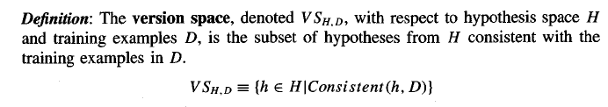
Basis of Classification: Inductive Learning
Satisfy versus Consistent, Version Space
an example x is said to satisfy hypothesis h when h(x) = 1,
regardless of whether x is a positive or negative example of the target concept (c).
an example is consistent with h depends on the target
concept, and in particular, whether h(x) = c(x)

Slide 26
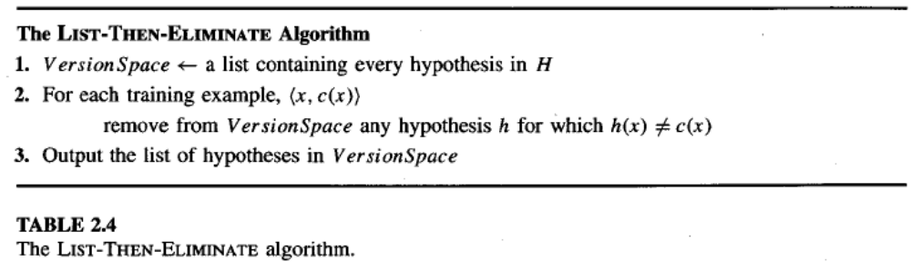
Basis of Classification: Inductive Learning
List –Then-Eliminate Algorithm
Begin with the most general hypothesis in H, eliminates any hypothesis found inconsistent with any training example. The version space of candidate hypotheses shrinks as more examples are observed, until ideally just one hypothesis remains that is consistent with all the observed examples. If insufficient data is available to narrow the version space to a single hypothesis, then the algorithm can output the entire set of hypotheses consistent with the observed data

Slide 27
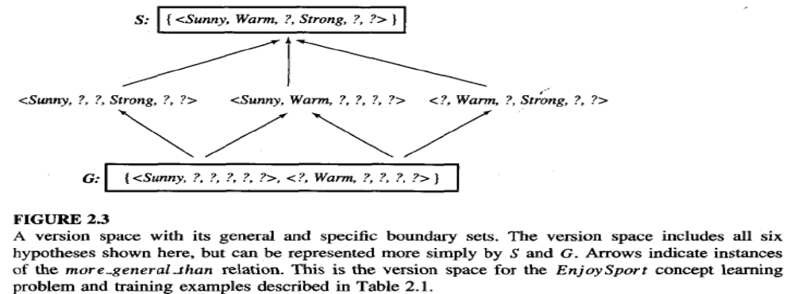
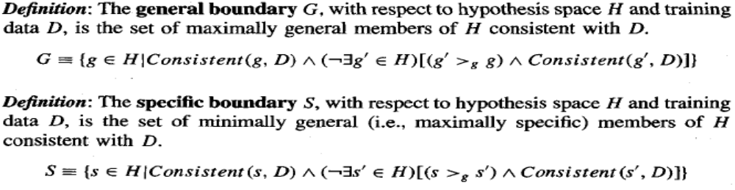
Basis of Classification: Inductive Learning

Slide 28
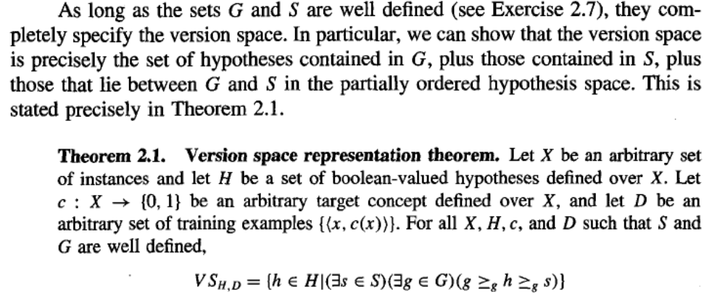
Basis of Classification: Inductive Learning
Version Space Representation Theorem

Slide 29
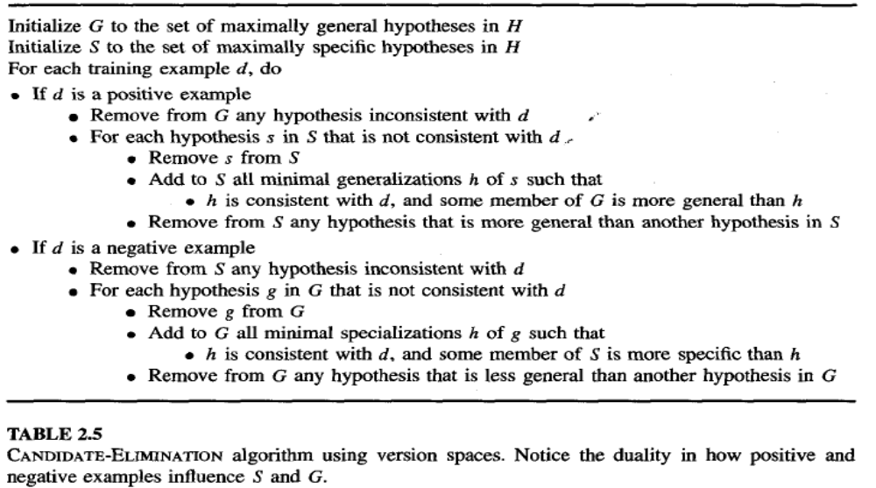
Basis of Classification: Inductive Learning
Candidate Elimination Algorithm

Slide 30
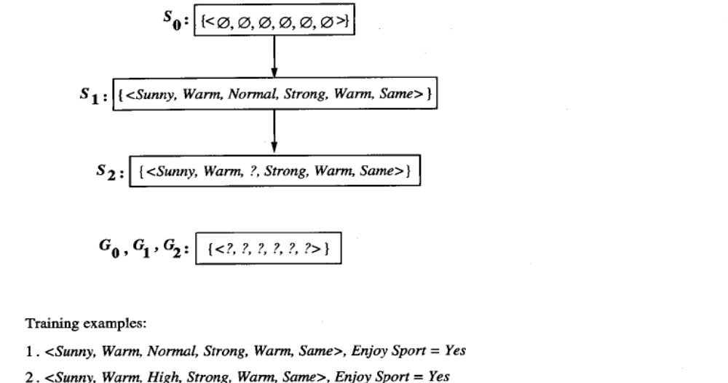
Basis of Classification: Inductive Learning
Candidate Elimination Algorithm

Slide 31
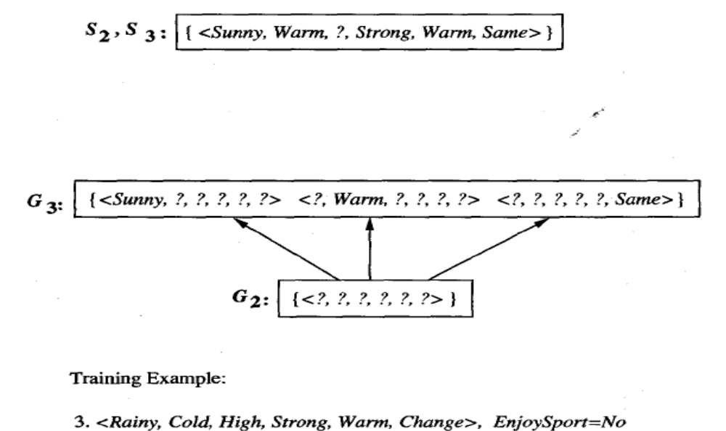
Basis of Classification: Inductive Learning
Candidate Elimination Algorithm

Slide 32
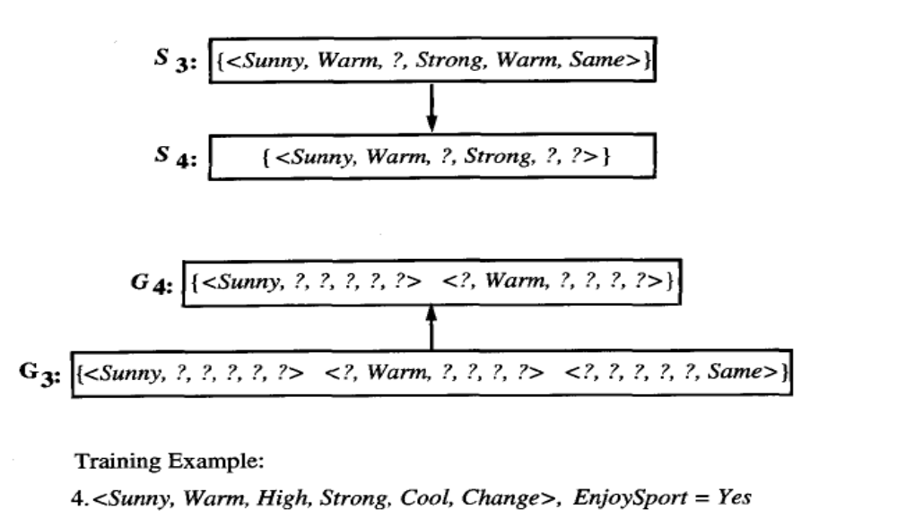
Basis of Classification: Inductive Learning
Candidate Elimination Algorithm

Slide 33
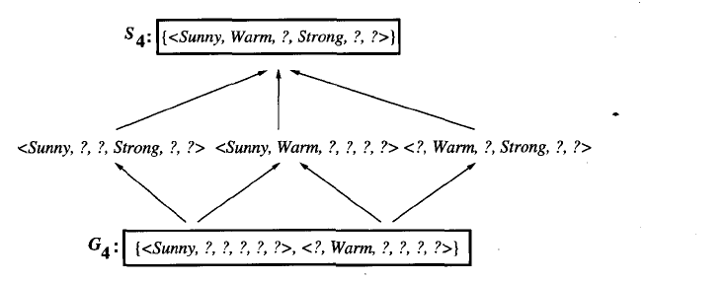
Basis of Classification: Inductive Learning
Candidate Elimination Algorithm

Slide 34
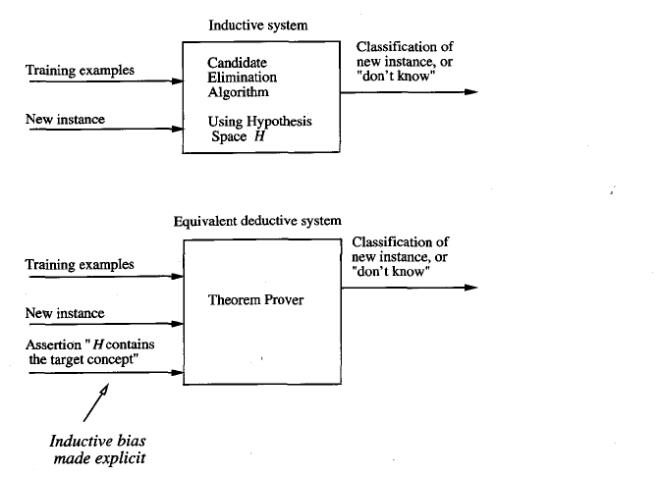
Basis of Classification: Inductive Learning
Candidate Elimination Algorithm

Slide 35
Week 8-End
read
  Course Text Book Chapter 6
  Supplemantary Book “Machine Learning”- Tom Mitchell Chapter 2

